Slide 1

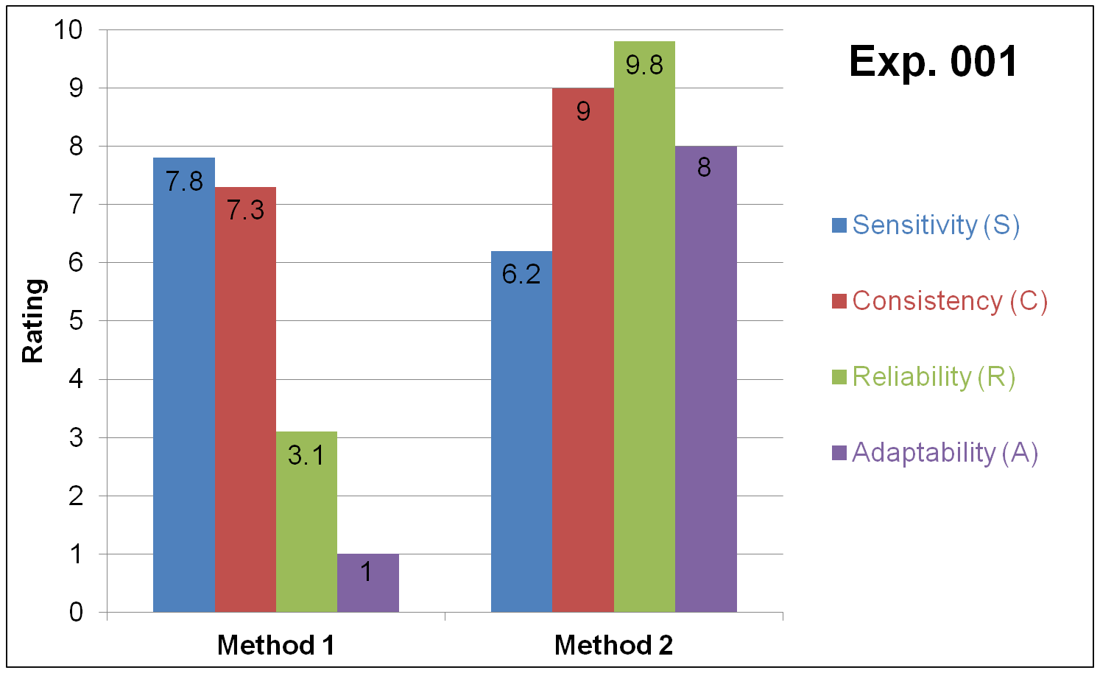
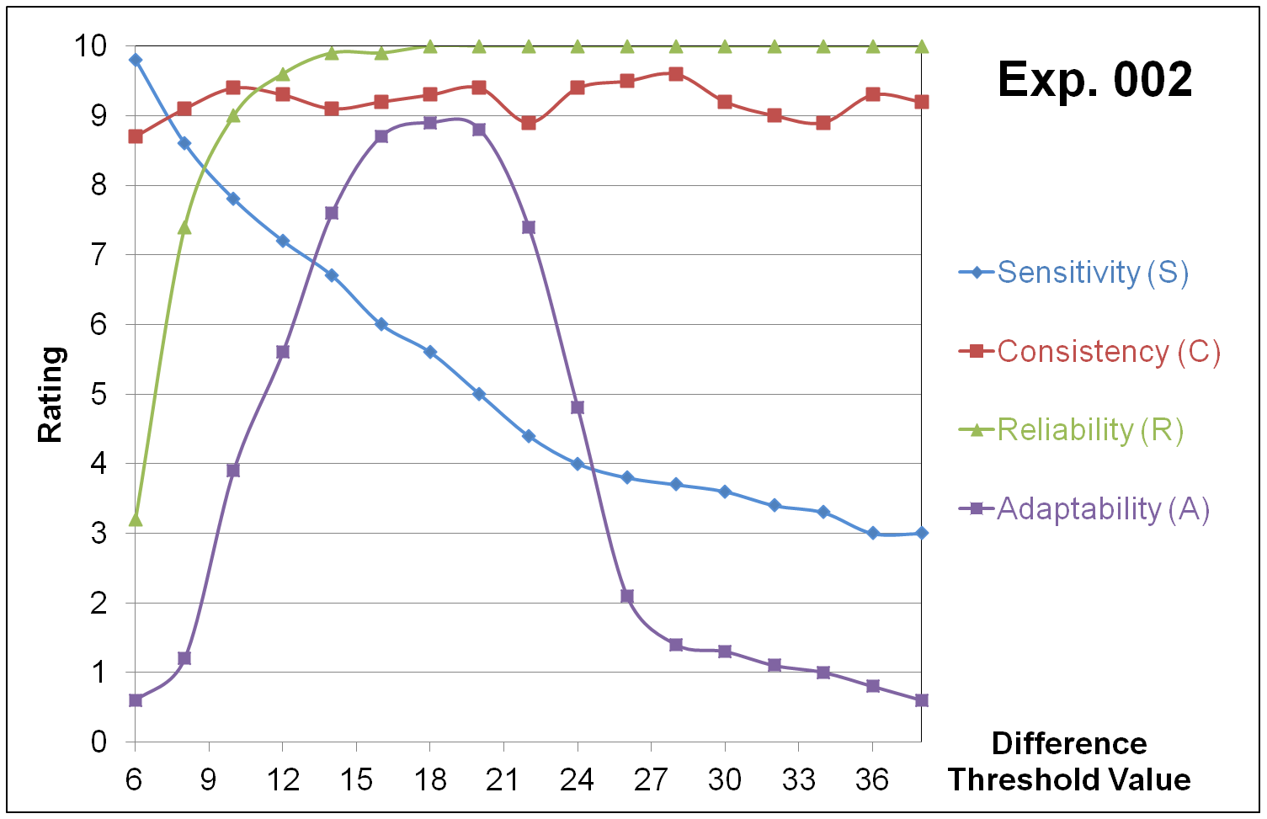
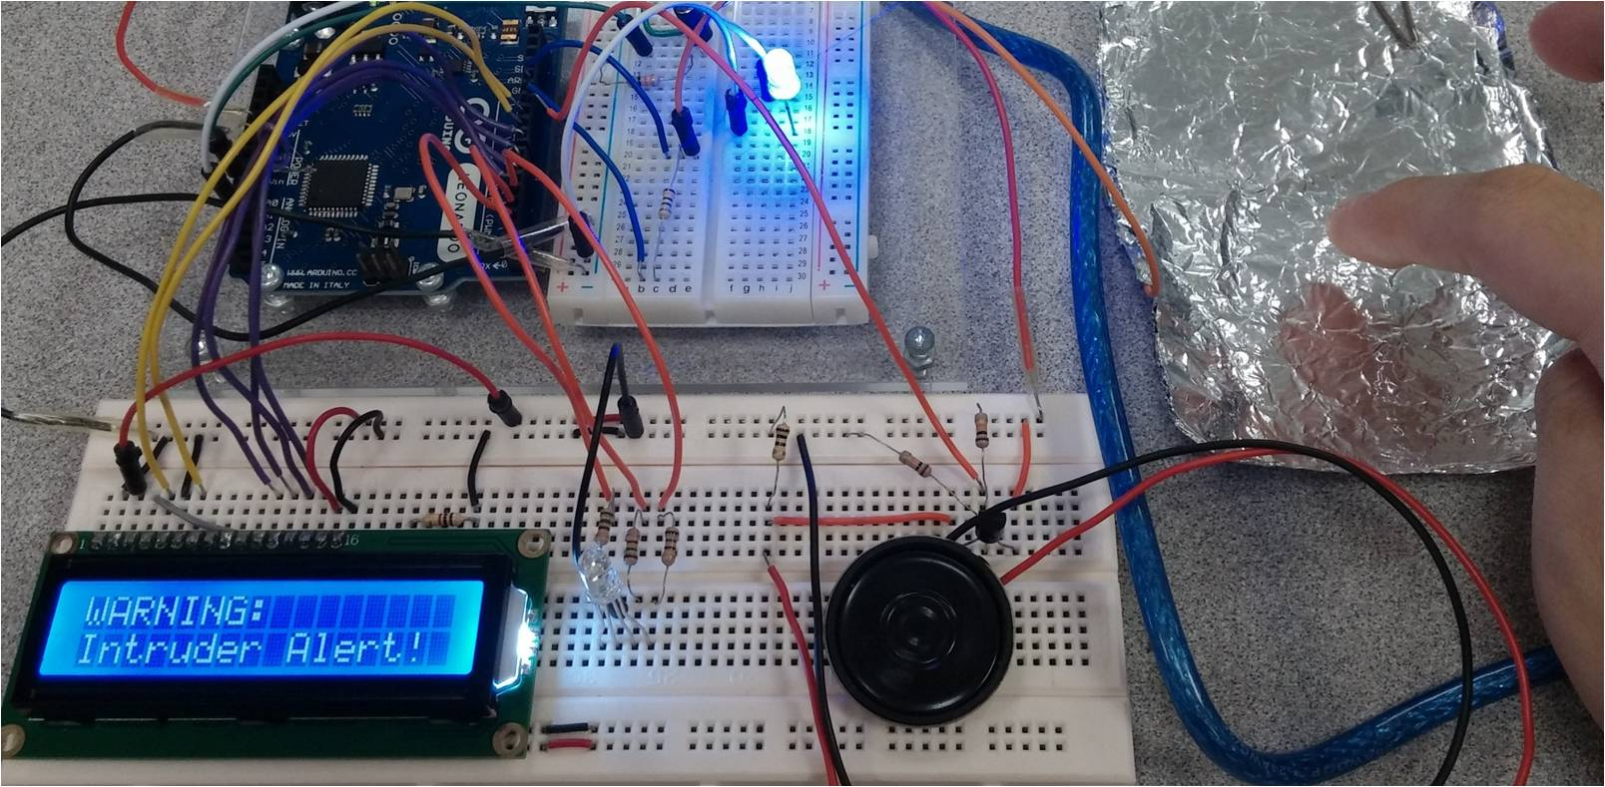
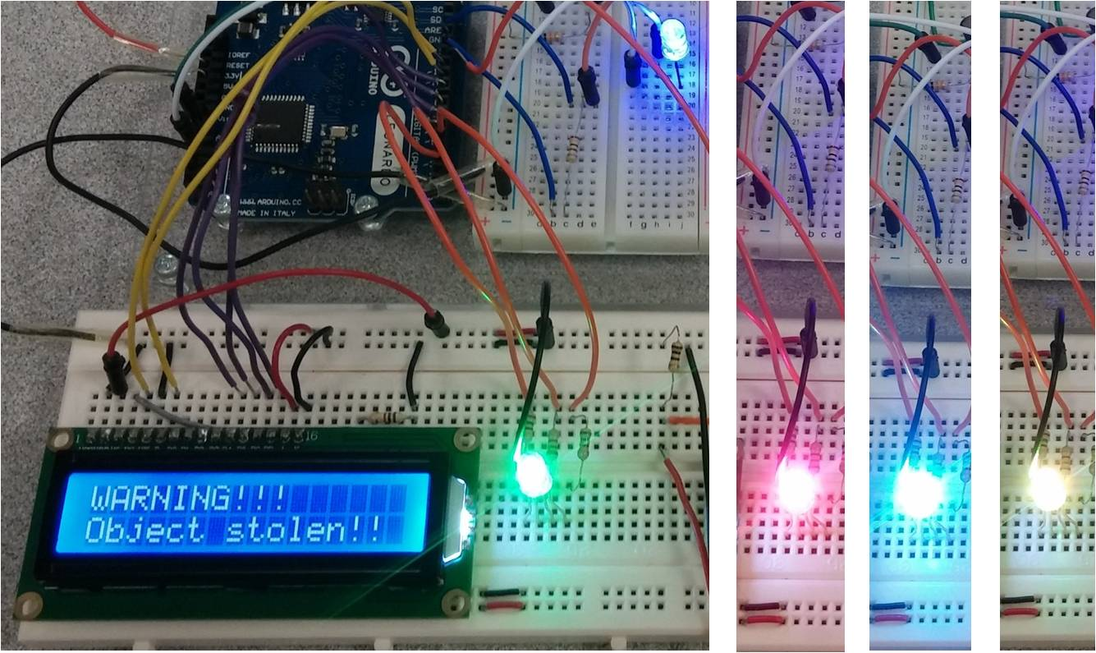
DESIGNING A SAFEKEEPING SYSTEM WITH HUMAN TOUCH DETECTION MODULE
Introduction
Need for an inexpensive and effective safekeeping system
available to a rising number of independent shop owners
and businesses in Singapore
Capacitive sensor combined with a tilt sensor offers the
cheapest solution that can still function effectively
Objective
To maximise the capability of our sensor by augmenting the following:
Sensitivity : receptiveness of the sensor to an approaching hand
Consistency : ability to repeatedly yield the same Sensitivity rating
Adaptability : effectiveness of sensor in different environments
Reliability : percentage of false alarm triggers
Methodology
Experiment 01: Evaluated the better method of alarm trigger in terms of SCAR.
Experiment 02: Simulated various scenarios of burglary and performed respective SCAR analyses for a range of possible trigger values
Results
Method 1 used a threshold value while Method 2 measured relative difference
Activating the capacitive sensor by touch detection. The entire system runs on a pre-programmed Arduino Leonardo microcontroller chip.
Activating the touch sensor by motion detection. This will trigger a separate protocol of alarms, including a tri-colour LED that can flash 7 different colours.
Conclusion
Method 2 is better than Method 1 as it makes the sensor more consistent, reliable and adaptable while being less sensitive as a minor trade-off
A difference threshold value (DTV) of 18 is the most universally applicable value. Lower DTVs of 10-14 can be used when sensitivity is the key factor.
Group Members:
Leow Ken Hing Bryan, Dunman High School
Mentors:
Professor Tan Kok Kiong, National University of Singapore
Associate Professor Arun Shankar Narayanan, National University of Singapore

